Slide 1
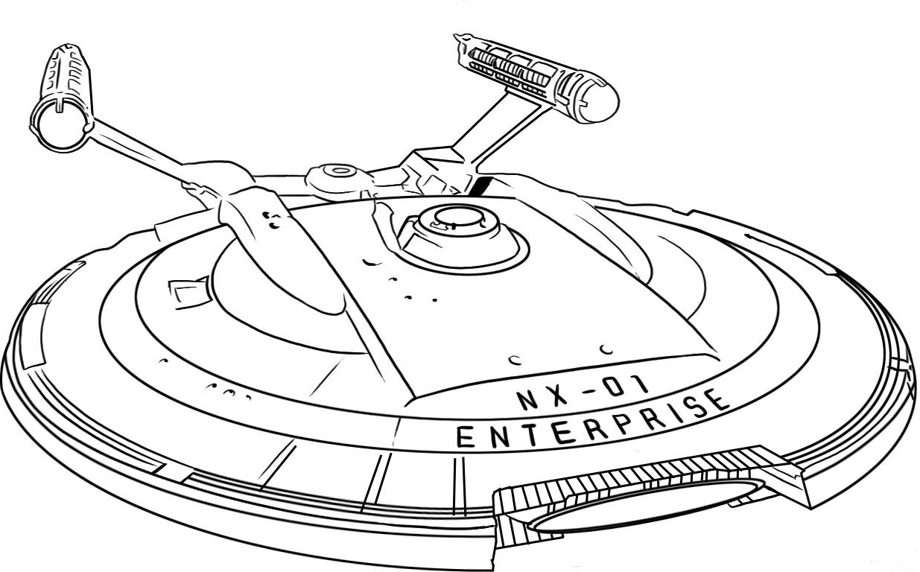
EECT 112-50C Lab Notebook
DIGITAL FUNDAMENTALS
Fall 2015
Olivia Koehler
12/18/15

Slide 2

Table of Contents
Lab 1 – AND, OR 3
Lab 2 – NAND Alternative 13
Lab 3 – NAND Equivalence 21
Lab 4 – Car Alarm 28
Lab 5 – Flip Flops 35
Lab 6 – 4 Bit Counter 43
Lab 7a – BASIC Stamp Single Input/Output 54
Lab 7b – BASIC Stamp Temp Sensor/Heater 61
Lab 8 - BASIC Stamp Binary Counter (software) 68

Slide 3

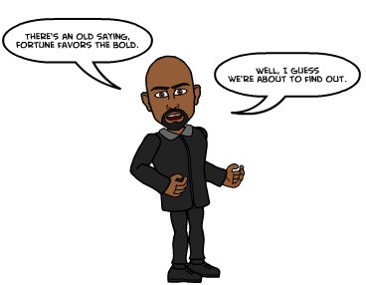
Lab 1 – AND, OR

Slide 4

Lab 1 – AND, OR
Purpose
    Learn how AND and OR gates work
Equipment and Material
    Breadboard, 74LS08, 74LS32, jumper wires
    MultiMeter: Gw Instek GDM-8245 SN: CL860260
    DC Power Supply: RSR HY1502D SN: 022510041
Research and Information
  - 74LS08, 74LS32 Data Sheets with Pinouts
  - Truth Table

Slide 5
Lab 1 – AND, OR
Procedures
- All combinations where measured for both And and OR gates. Measurements of the outputs where taken with the aid of a Digital Multimeter.
- All results found in excel, multisim and in the lab, agreed with on another.

Slide 6

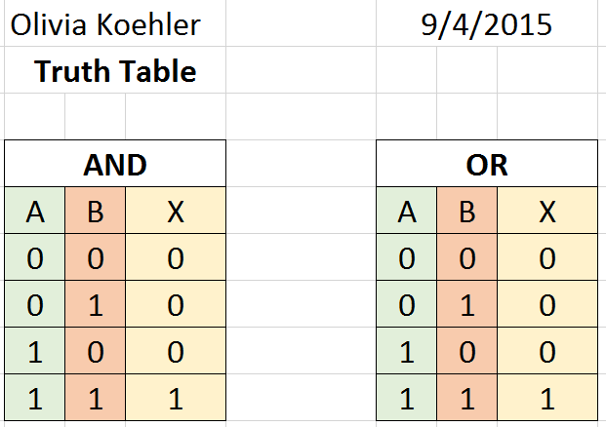

Lab 1 – AND, OR
(Excel)

Slide 7
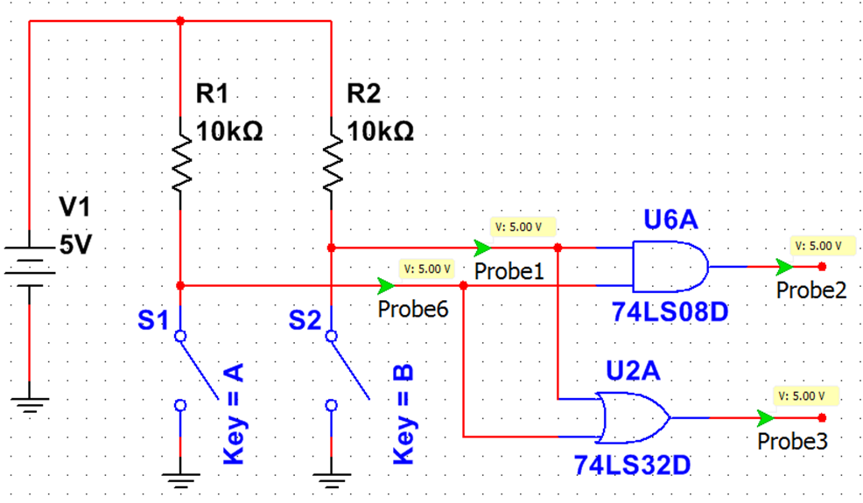
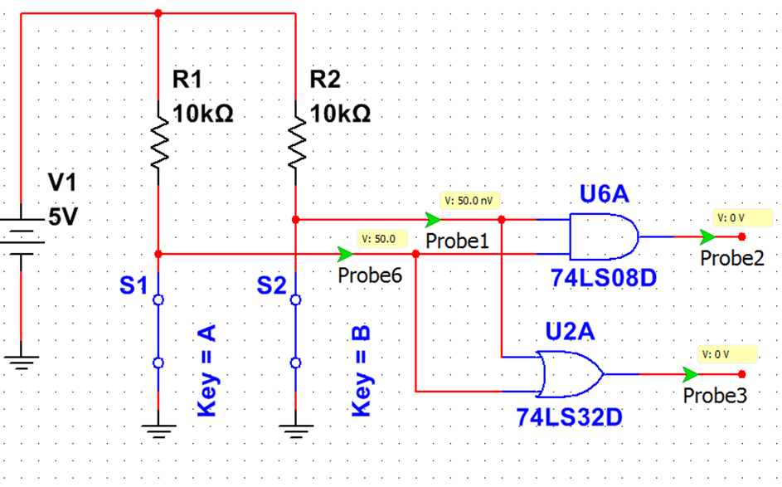
Lab 1 – AND, OR
(Multisim)
The AND and OR gates, behave according to the Truth Table in Excel.
1 1
0 0

Slide 8
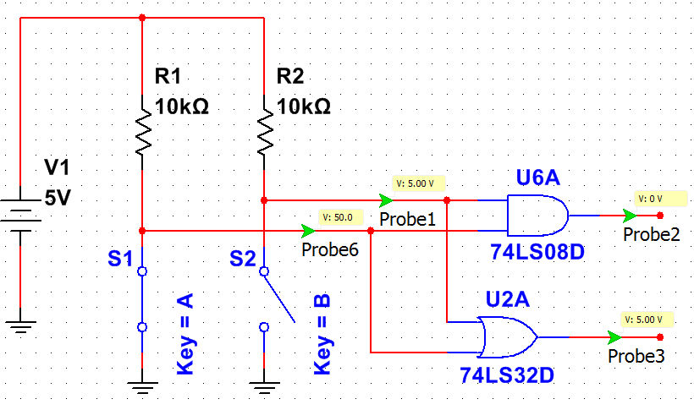
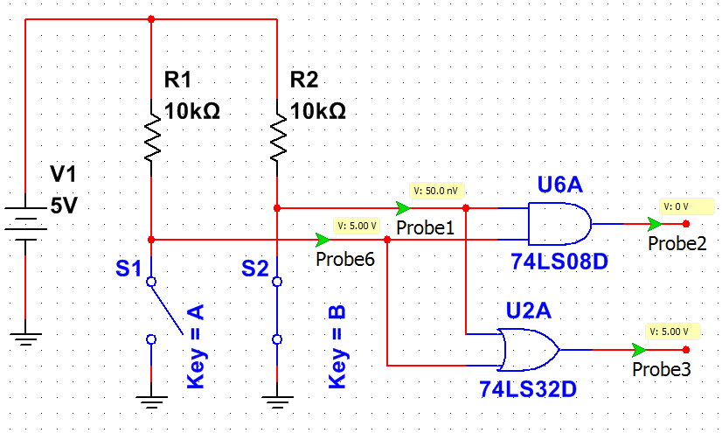
Lab 1 – AND, OR
(Multisim)
0 1
1 0

Slide 9
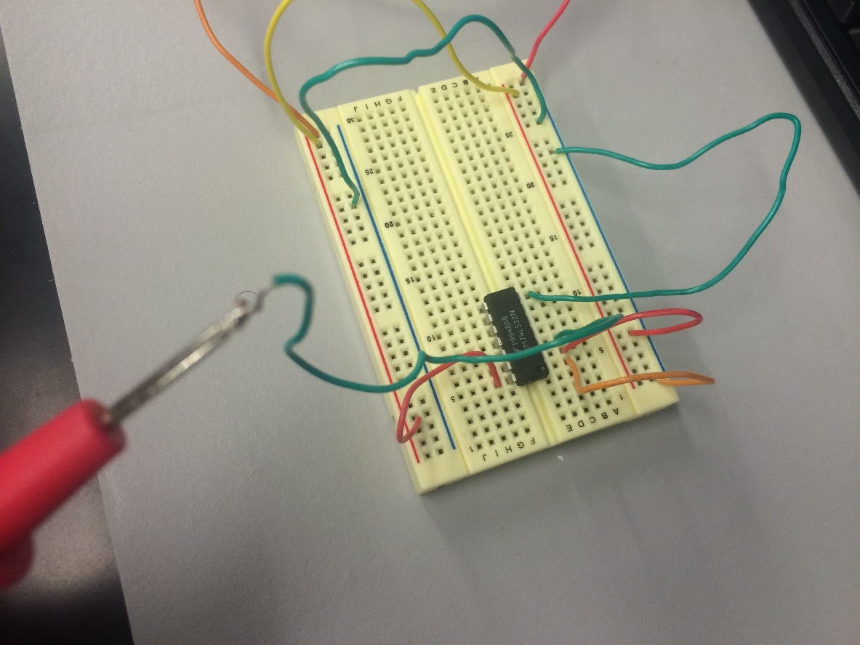
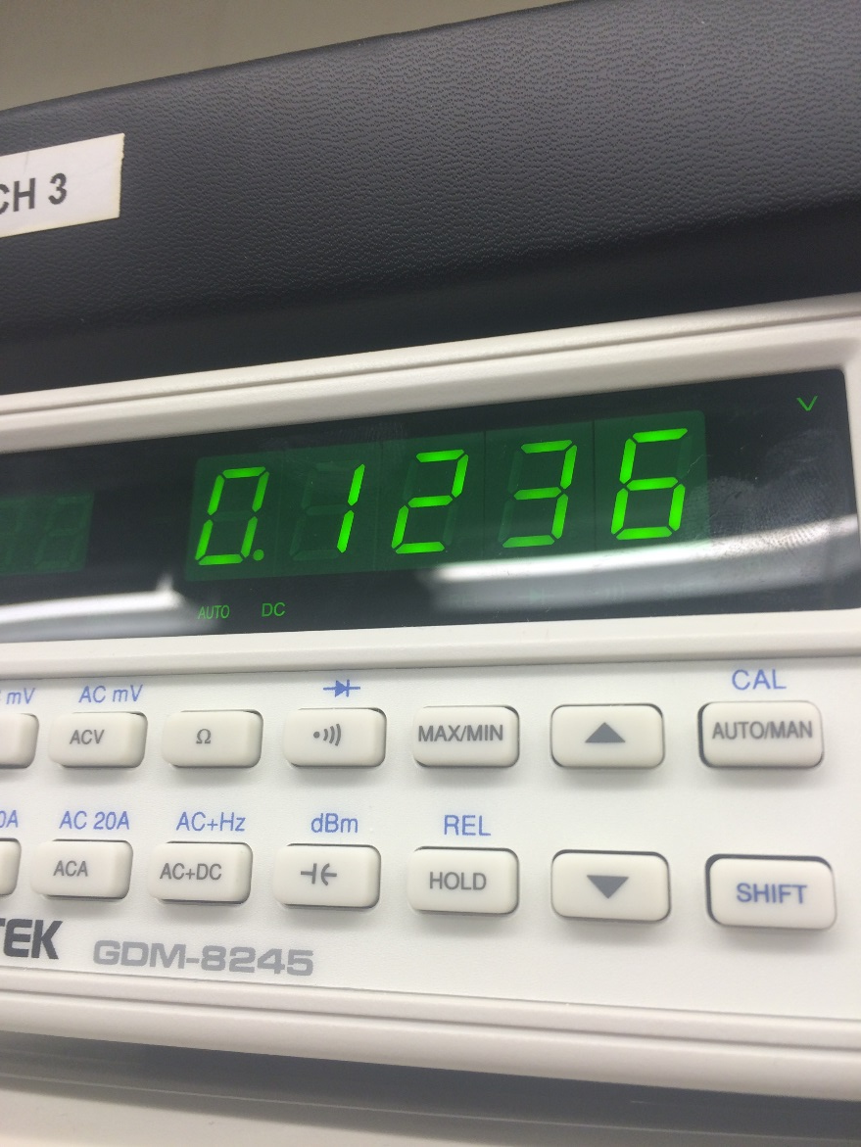
Lab 1 – AND, OR
Pictures
74LS08

Slide 10
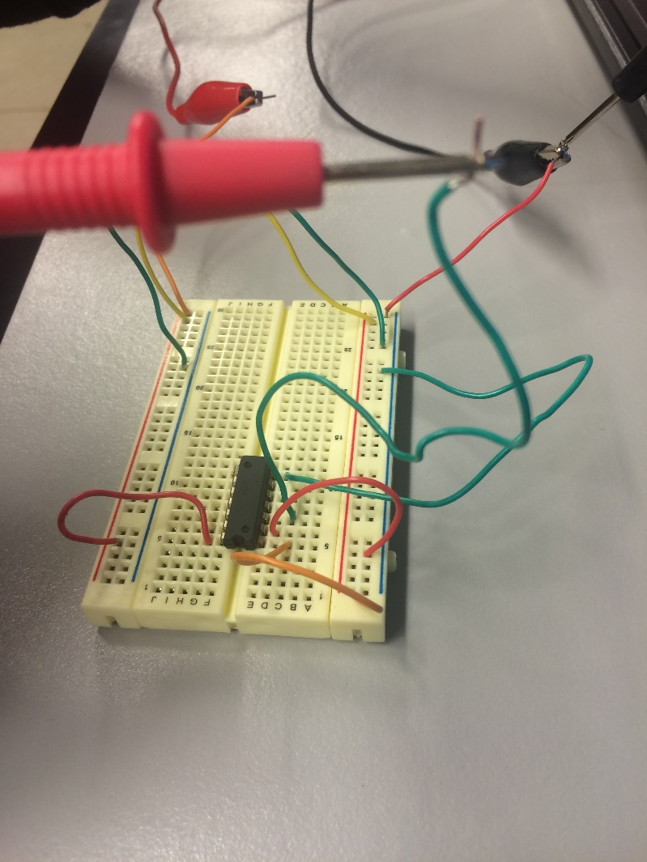
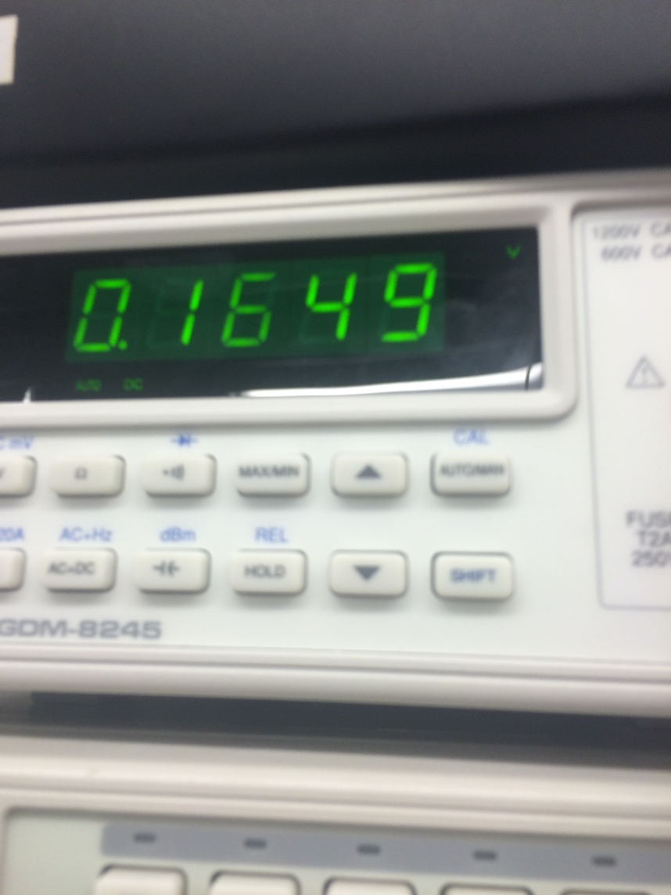
Lab 1 – AND, OR
Pictures
74LS32

Slide 11

Lab 1 – AND, OR
(Observation)
Logic low levels were well below .8V max
for logic zero, mostly measuring .12V.
Logic high levels were very close to the
max for logic, mostly measuring 4.5V.

Slide 12
Lab 1 – AND, OR
(Conclusion)
  - All results in multisim, excel and in the lab coincided with one another.
  - At first the wiring was wrong on the bread bored, it was not properly grounded. After carful trouble shooting, the problem was resolved.
  - I learned how chips are used, and how to properly hook one up on a bread bored.

Slide 13

Lab 2 – NAND Alternative

Slide 14

Lab 2 – NAND Alternative
Purpose
    Learn how NAND gates operate
Equipment and Material
    Breadboard, 74LS08, 74LS32, jumper wires, resistors
    MultiMeter: Gw Instek GDM-8245 SN: CL860260
    DC Power Supply: RSR HY1502D SN: 022510041
Research and Information
  http://www.allaboutcircuits.com/textbook/digital/chpt-7/introduction-boolean-algebra/ (Intro to Boolean Algebra)
  http://hyperphysics.phy-astr.gsu.edu/hbase/electronic/diglog.html
  (Theorems Boolean Algebra)

Slide 15

Lab 2 – NAND Alternative
Procedures
- Using both an AND and OR gate, NOTS were added to the original AND/OR circuits. Using a Mulitmeter, it was measured how this changed each output on both gates.
- All results found in excel, multisim and in the lab, agreed with on another.

Slide 16
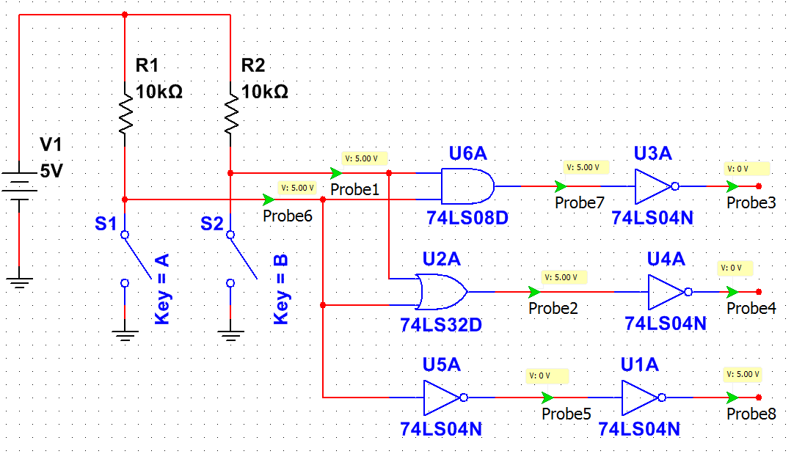
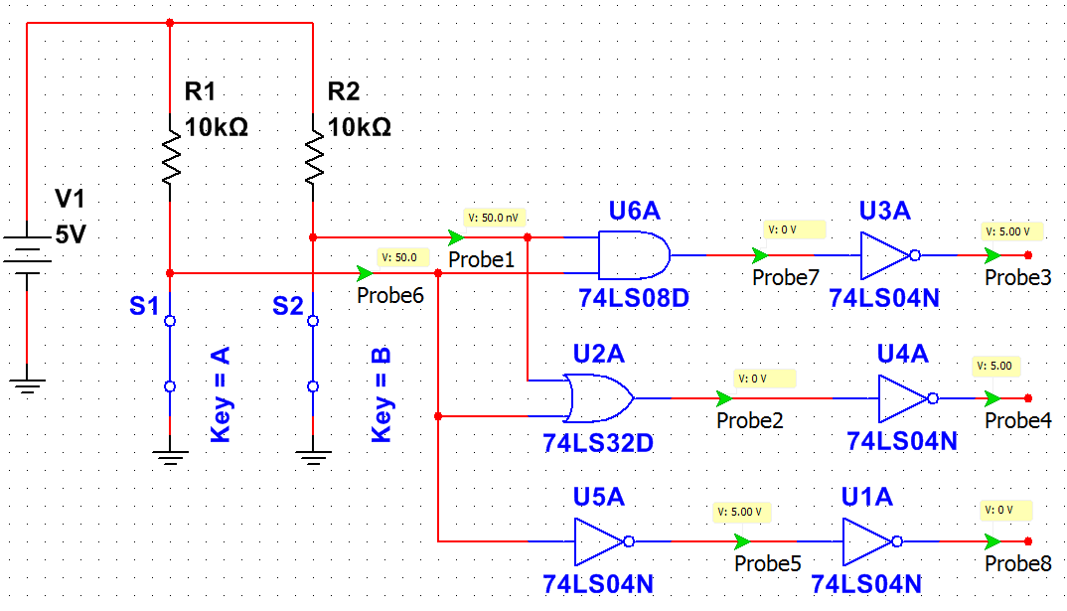
Lab 2 – NAND Alternative
(Multisim)
1 1
0 0

Slide 17
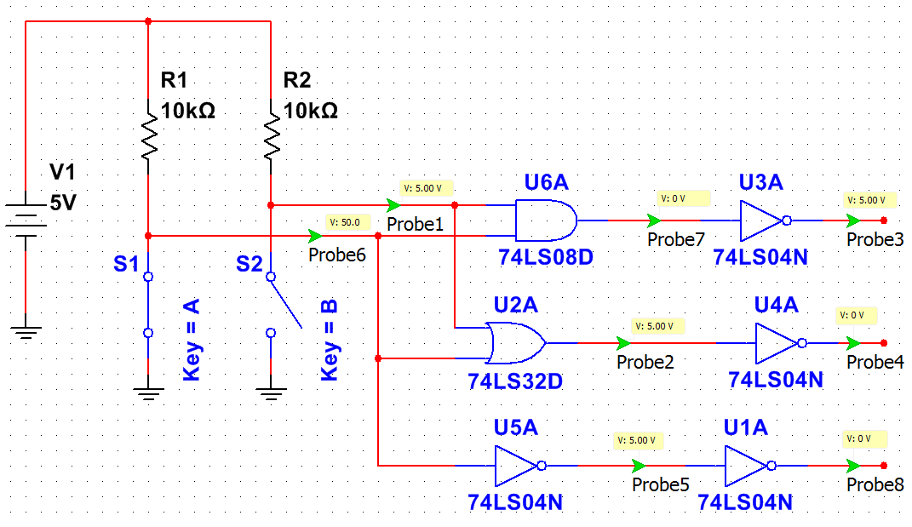
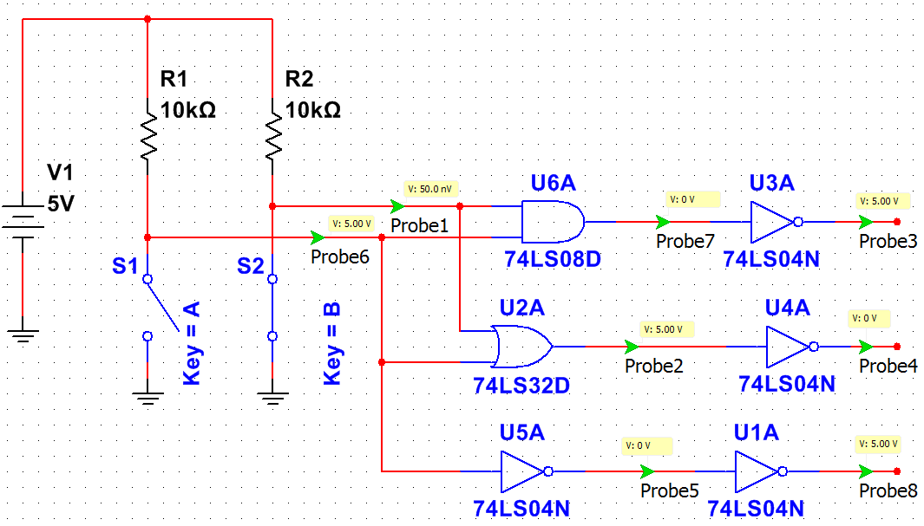
Lab 2 – NAND Alternative
(Multisim)
0 1
1 0

Slide 18
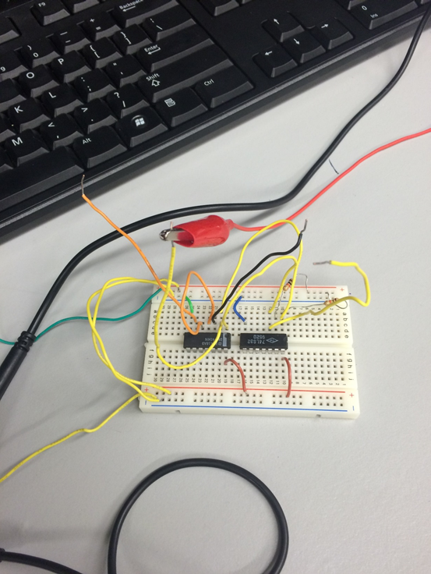
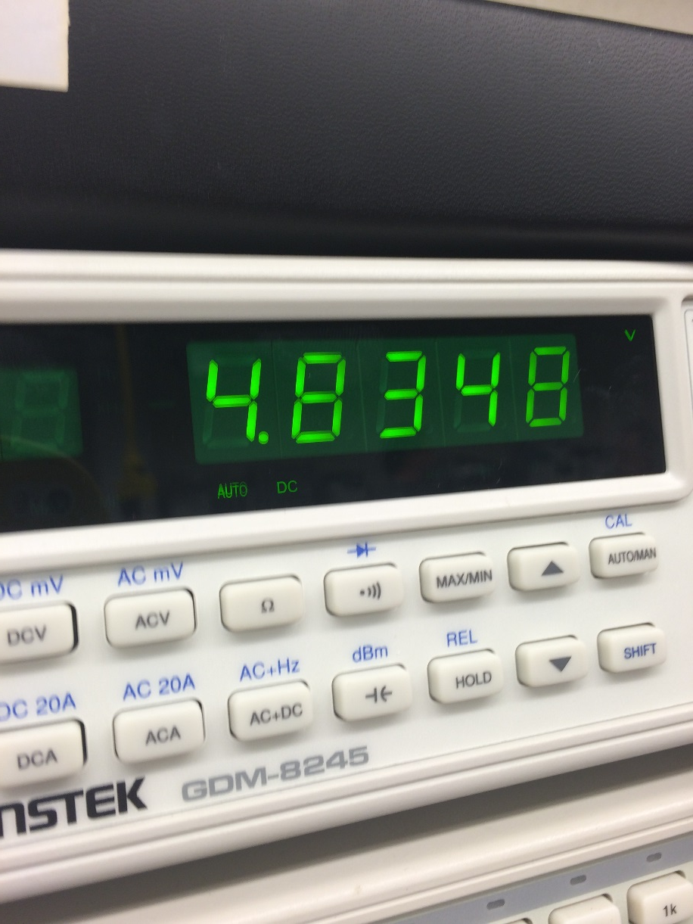
Lab 2 – NAND Alternative
Pictures

Slide 19

Lab 2 – NAND Alternative
(Observation)
V1 and V2 were opposites with one another, while V3 was equal to V4.
4.8V was the highest measurement taken, which was from the AND gate.

Slide 20
Lab 2 – NAND Alternative
(Conclusion)
  - All results in multisim, excel and in the lab agreed with one another.
  - I learned how to hook up two chips onto one board, and to get proper readings from them.
  - After the lab, I finally was able to understand what happens what you add a not to the gates. Which causes the inverse of the desired outcome.

Slide 21

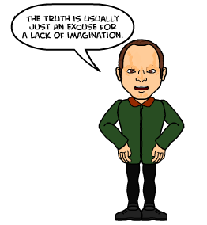
Lab 3 – NAND Equivalence

Slide 22

Lab 3 – NAND Equivalence
Purpose
    Learn about NAND equivalence
Equipment and Material
    Four Chips, four 10k Resistors, jumper wires
    Elvis Board: ELVIS II+ SN:166911A
Research and Information
- Multisim schematic
https://www.youtube.com/watch?v=pg4DI5s8FNo (Multisim)
https://www.youtube.com/watch?v=Hi3RzHIeqWw (NAND Gates)

Slide 23
Lab 3 – NAND Equivalence
Procedures
- All combinations where measured for both And and OR gates. Measurements of the outputs where taken with the aid of a Digital Multimeter.
- All results found in excel, multisim and in the lab, agreed with on another.

Slide 24
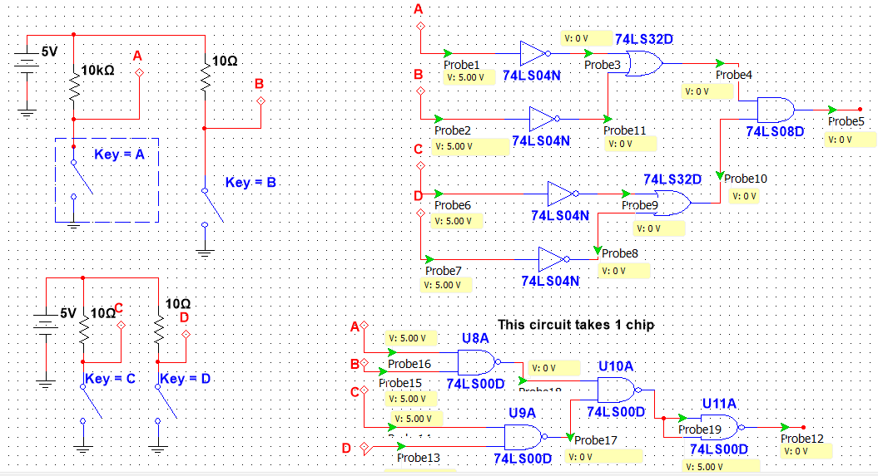
Lab 3 – NAND Equivalence
(Multisim)

Slide 25
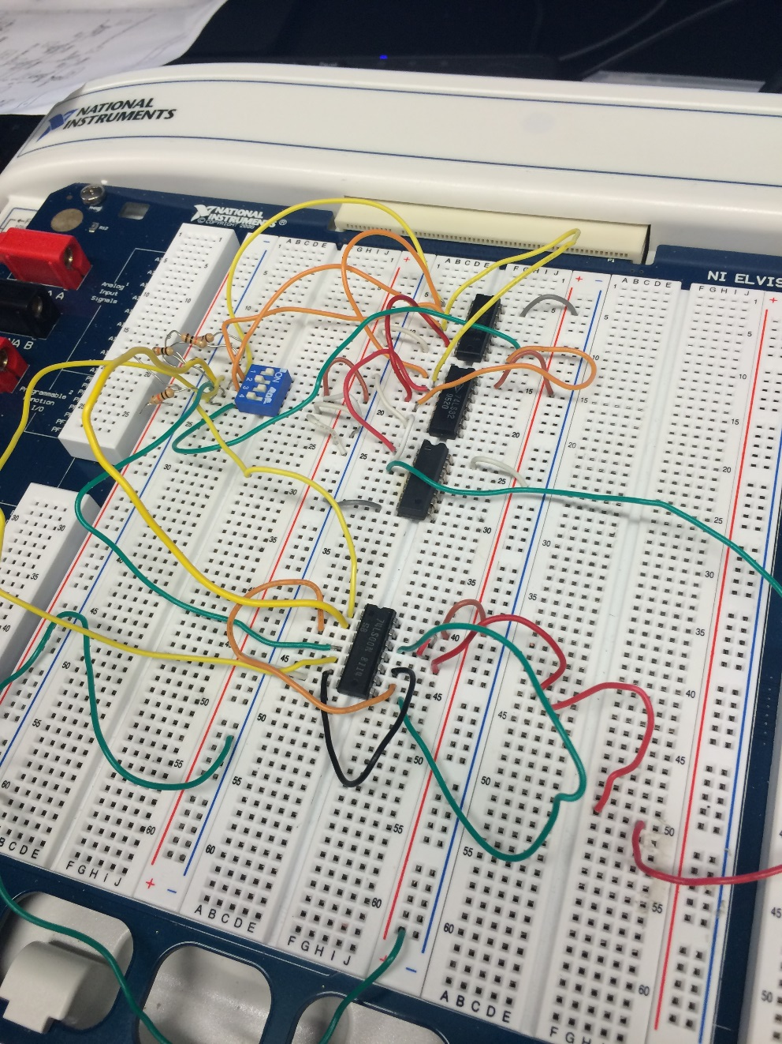
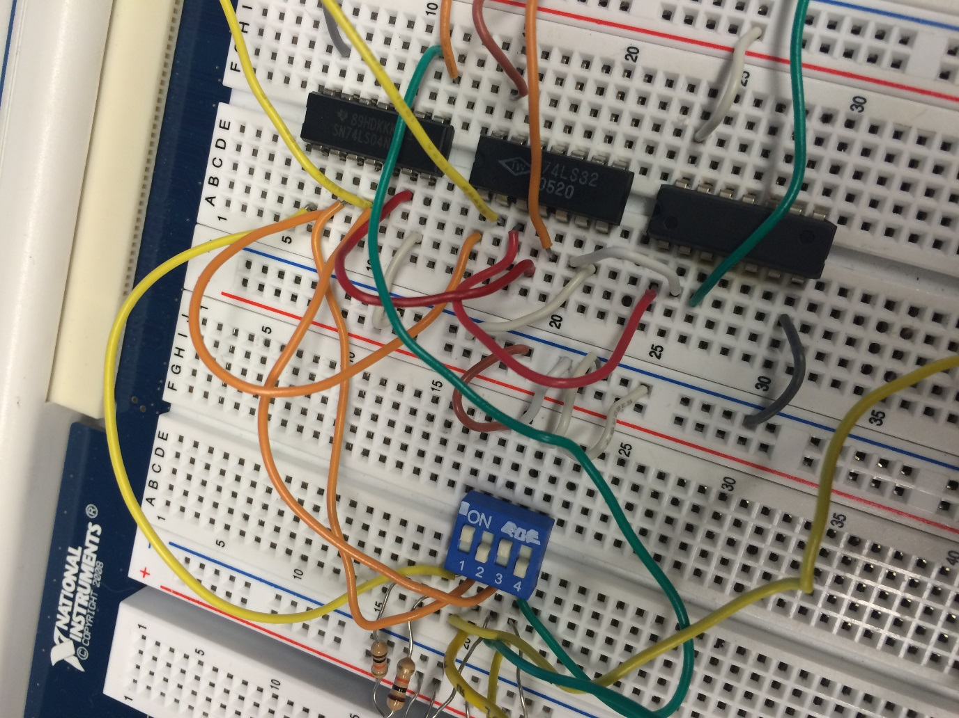
Lab 3 – NAND Equivalence
(Pictures)

Slide 26

Lab 3 – NAND Equivalence
(Observations)
After looking over a schematic for each of the chips, we were able to hook up the chips easily.
Also, learned how to properly distinguish which end of the chip is the top.

Slide 27
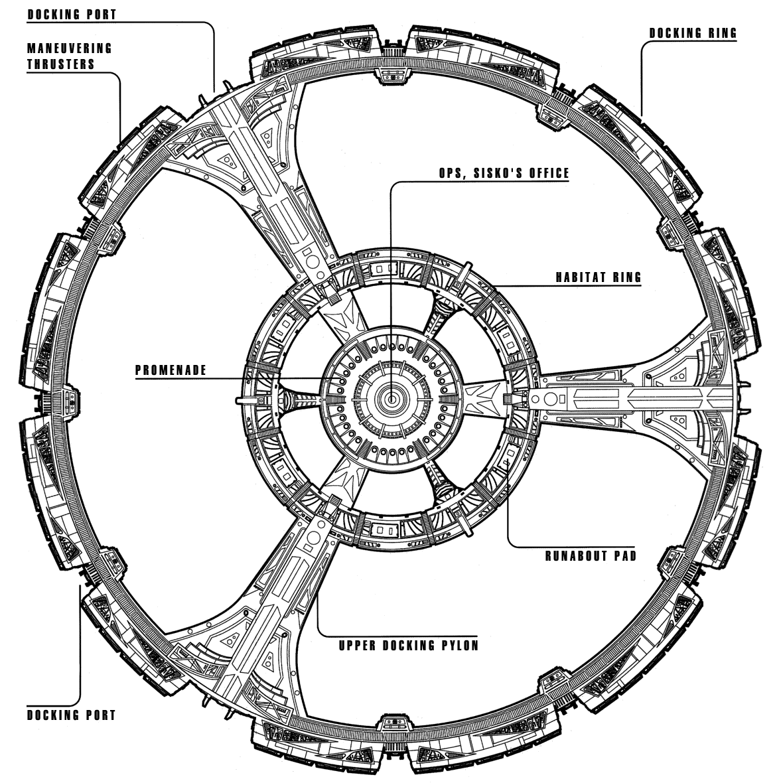
Lab 3 – NAND Equivalence
(Conclusion)
  Was able to hook up everything pretty quickly, now that I have become used to dealing with IC’s.
  Even though the wires seem to be a mess, I am able to look at them and know what the purpose of each one is.

Slide 28

Lab 4 – Car Alarm

Slide 29

Lab 4 – Car Alarm
Purpose
    Designing logic for a Car Alarm given input and output requirements and going from start to finish
Equipment and Material
    Chips: 74LS00, 74LS08, ANOTHER, jumper wires, Dip Switch
    MultiMeter: Gw Instek GDM-8245 SN: CL860260
    Elvis Board: ELVIS II+ SN:166911A
Research and Information
  - Multisim circuit layout
  - Datasheets for Chips

Slide 30
Lab 4 – Car Alarm
Procedures
Using an AND, OR, and NOT gates, a car alarm circuit was built. It was to be built in such a way, certain combinations would turn a light (alarm) on or off.
- The challenge was to find way to use the least amount of chips on the board as possible.

Slide 31
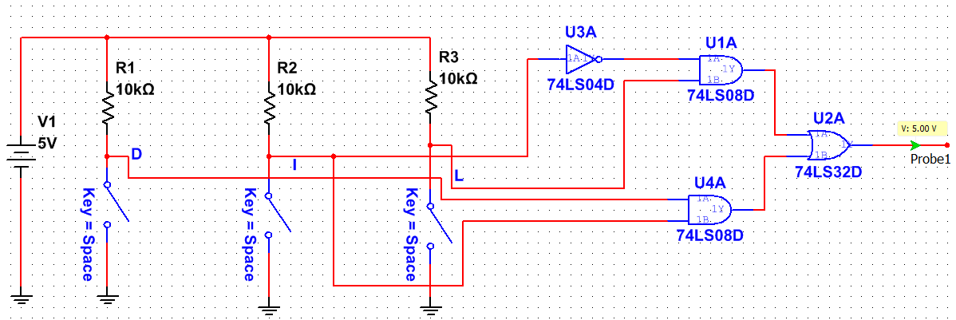
Lab 4 – Car Alarm
(Multisim)

Slide 32
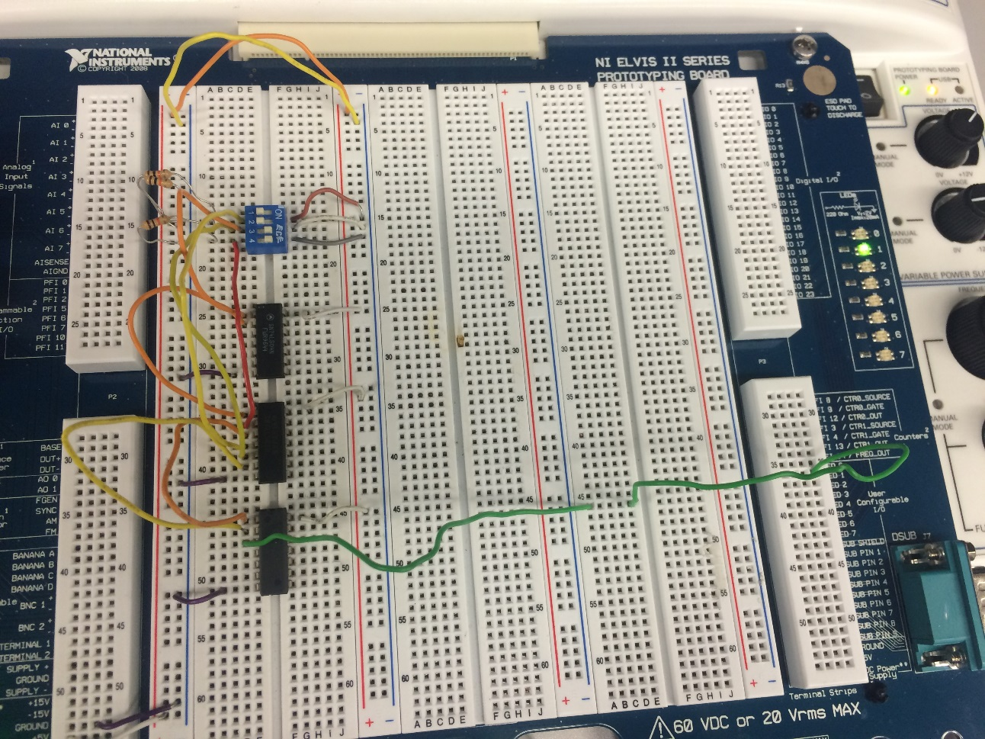
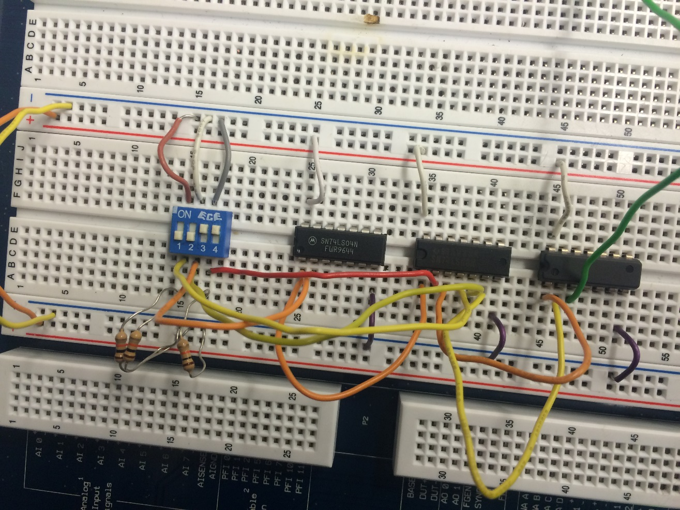
Lab 4 – Car Alarm
Pictures

Slide 33
Lab 4 – Car Alarm
(Observation)
It is best to keep the amount of chips used in a circuit to a minimum. There are a plethora of combinations that can be made with simply one AND, one OR as well as one NOT.
My circuit was pieced together easily, I had no issue hooking up my circuit.

Slide 34
Lab 4 – Car Alarm
(Conclusion)
  - All results in multisim and in the lab agreed with one another.
  - I learned how to minimize the use of chips on the board, by using Boolean theorems.
  - After the lab, I found that I am able to hook up digital circuits much easier. I have found a better understanding of how to utilize both datasheets and different types of chips.

Slide 35

Lab 5 – Flip Flops

Slide 36

Lab 5 – Flip Flops
Purpose
    Learn and understand latches and flip flops.
Equipment and Material
    Breadboard, 7400N, jumper wires, resistors, and dip switches
    MultiMeter: Gw Instek GDM-8245 SN: CL860260
    DC Power Supply: RSR HY1502D SN: 022510041
    Elvis Board: ELVIS II+ SN:166911A
Research and Information
  - Multisim circuit layout

Slide 37
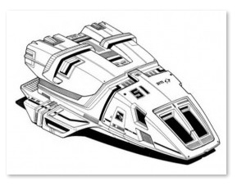
Lab 5 – Flip Flops
Procedure
Used breadboard, variable power supply, clip leads, DMM to measure supply voltage, built NAND SR latch using dip switches and pull up resistors. Used LED for output. Used 2 channel scope to show both traces like in Multisim. The circuit picks one state or the other; no oscillations. However, the same output does not go active every time power is applied.

Slide 38
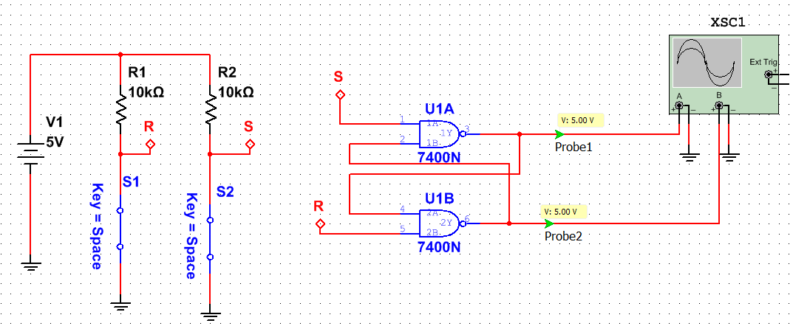
Lab 5 – Flip Flops
(Multisim)

Slide 39
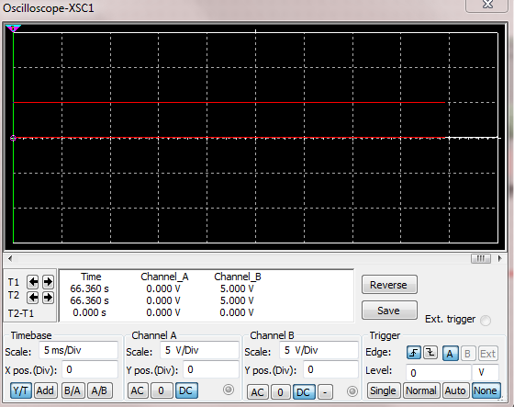
Lab 5 – Flip Flops
(Multisim)

Slide 40
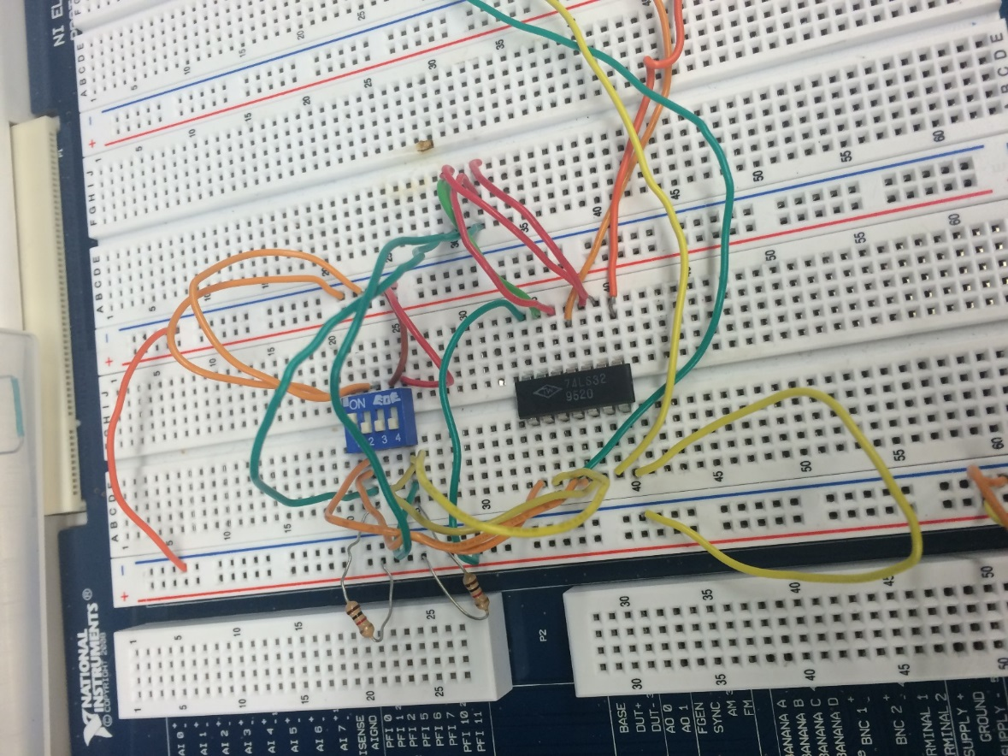
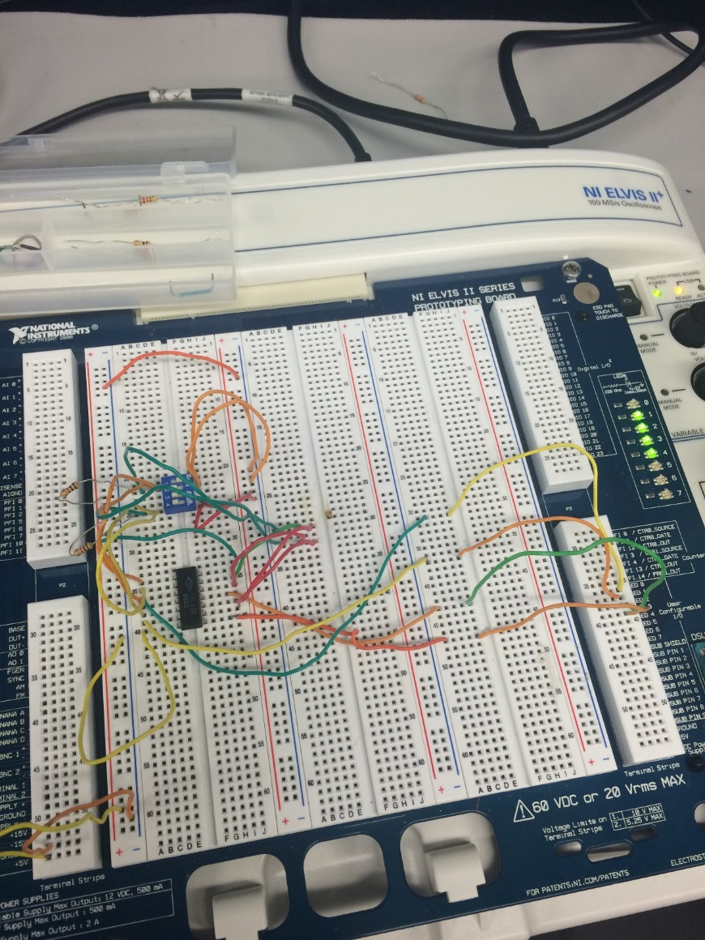
Lab 5 – Flip Flops
Pictures

Slide 41

Lab 5 – Flip Flops
(Observation)
No matter how many times we would flip the switches, the results received were always random.

Slide 42

Lab 5 – Flip Flops
(Conclusion)
  - All results in multisim, and in the lab testing agreed with one another.
  I learned how to flip flop chips on a board.
  Everything was easily hooked up.

Slide 43

Lab 6 – 4 Bit Counter

Slide 44

Lab 6 – 4 Bit Counter
Purpose
    Make a four bit counter using a 555 timer
Equipment and Material
    74LS08, 74LS32, jumper wires, resistors
    MultiMeter: Gw Instek GDM-8245 SN: CL860260
    DC Power Supply: RSR HY1502D SN: 022510041
    Elvis Board: ELVIS II+ SN:166911A
Research and Information
  - Multisim circuit layout
  - Datasheets

Slide 45

Lab 6 – 4 Bit Counter
Procedures
Using Multisim, built a 4-bit binary counter to count from 0000 to 1111 using D-Flip Flops, 74LS74D, as Toggle flip flops. Used a new input, digital clock set to 1Hz for clock signal. Used a Logic Analyzer to show traces. Switched to a DCD_HEX_GREEN 7-Segment Display that accepts the 4-bit counter states and displays the HEX value, thus counting from 0 to F for the 0-15 binary states. Converted Flip Flops to one chip binary counter using chips available in lab.

Slide 46
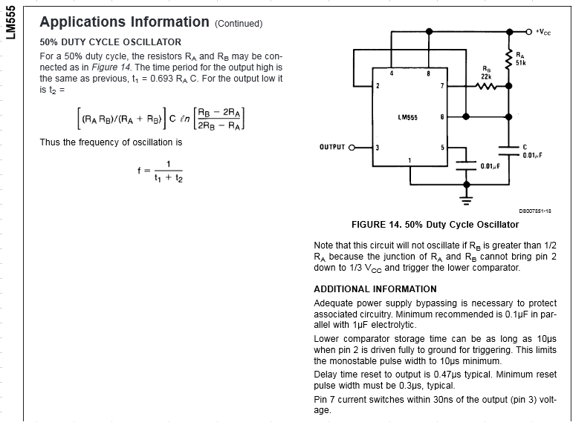
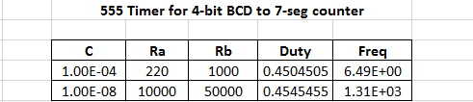
Lab 6 – 4 Bit Counter
(Excel)

Slide 47
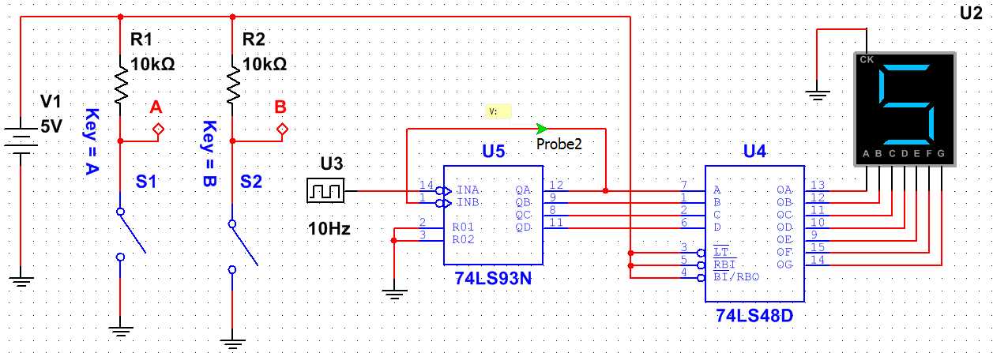
Lab 6 – 4 Bit Counter
(Multisim)

Slide 48
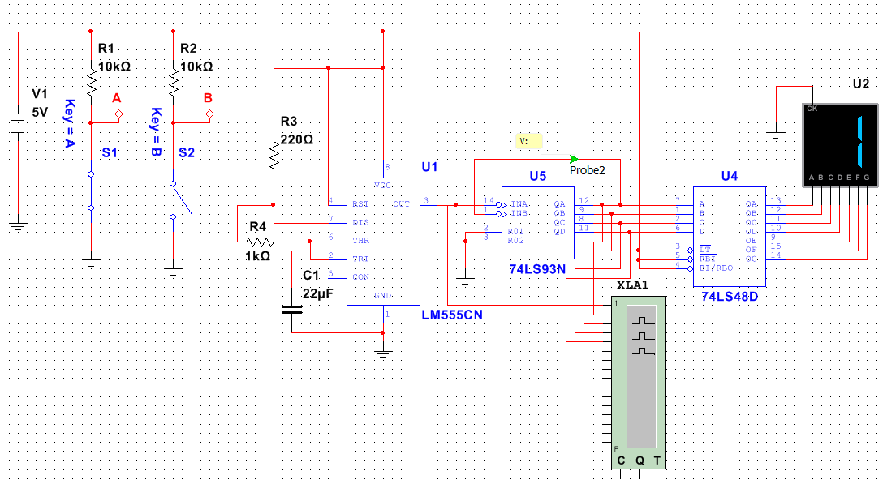
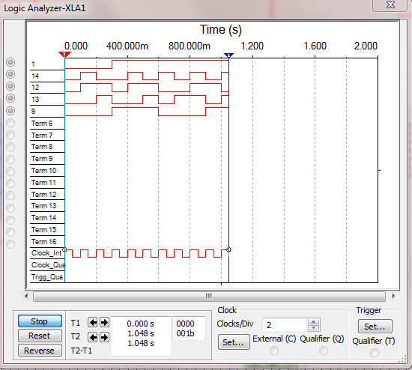
Lab 6 – 4 Bit Counter
(Multisim)

Slide 49
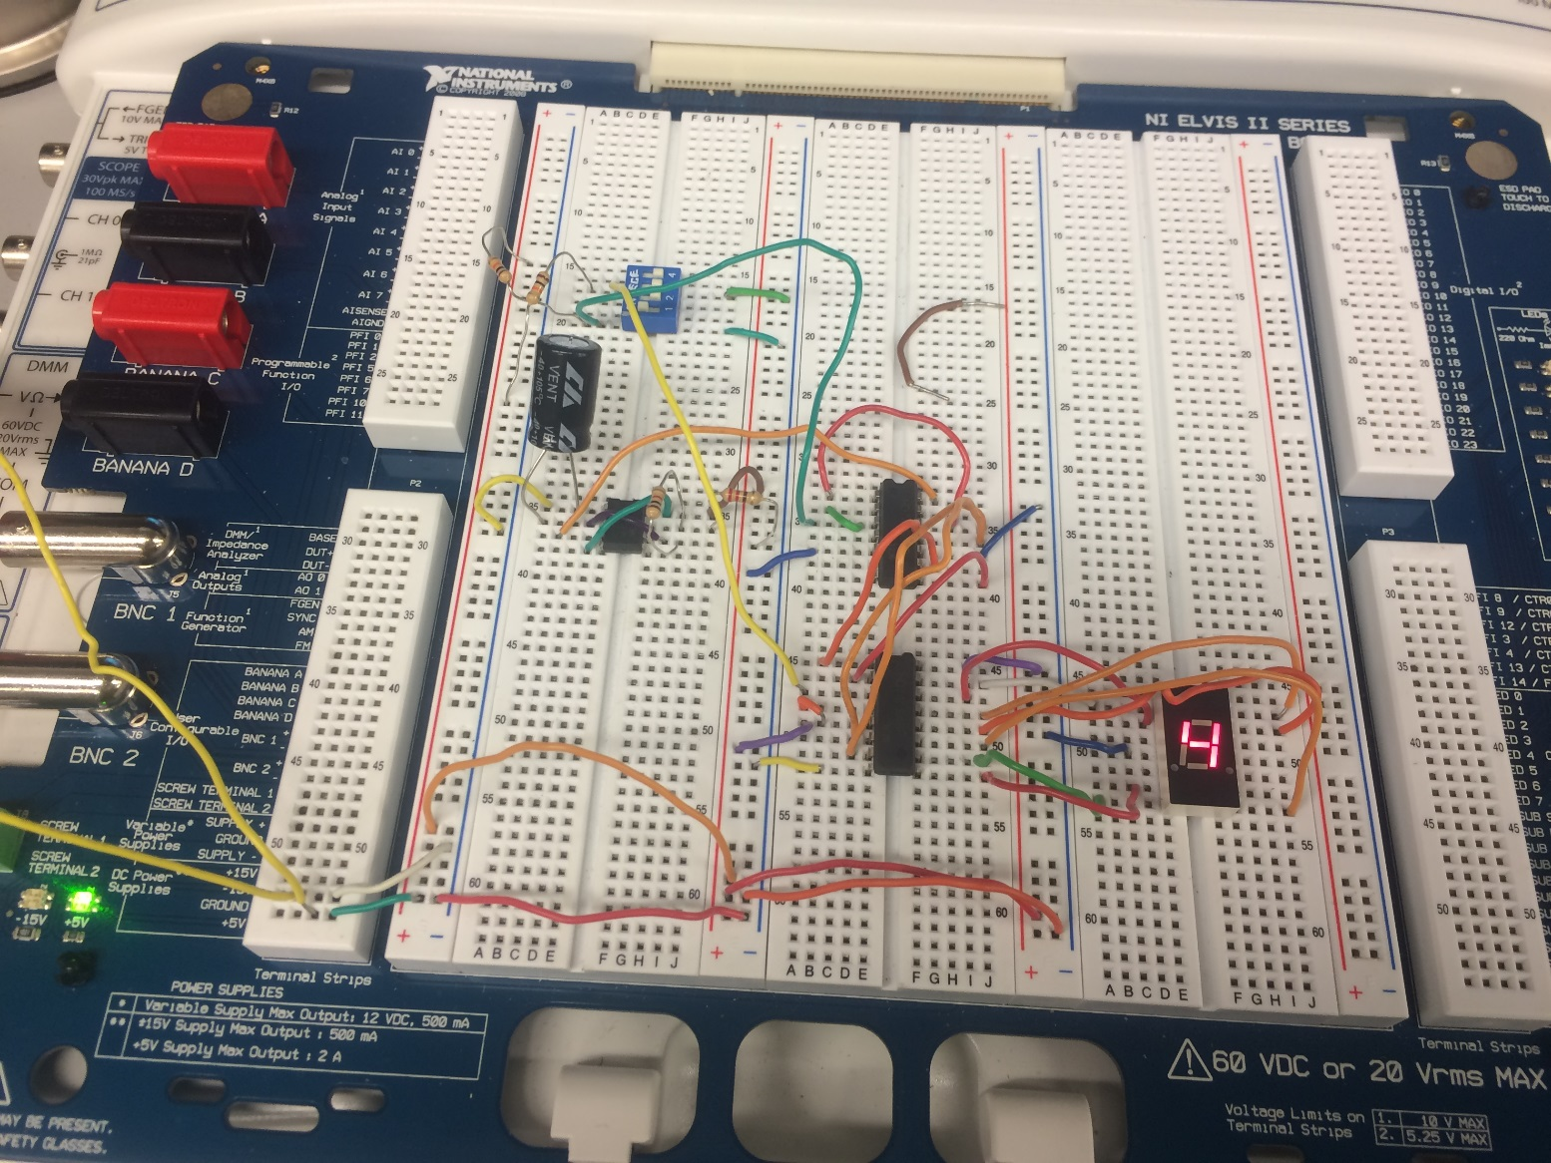
Lab 6 – 4 Bit Counter
Pictures

Slide 50
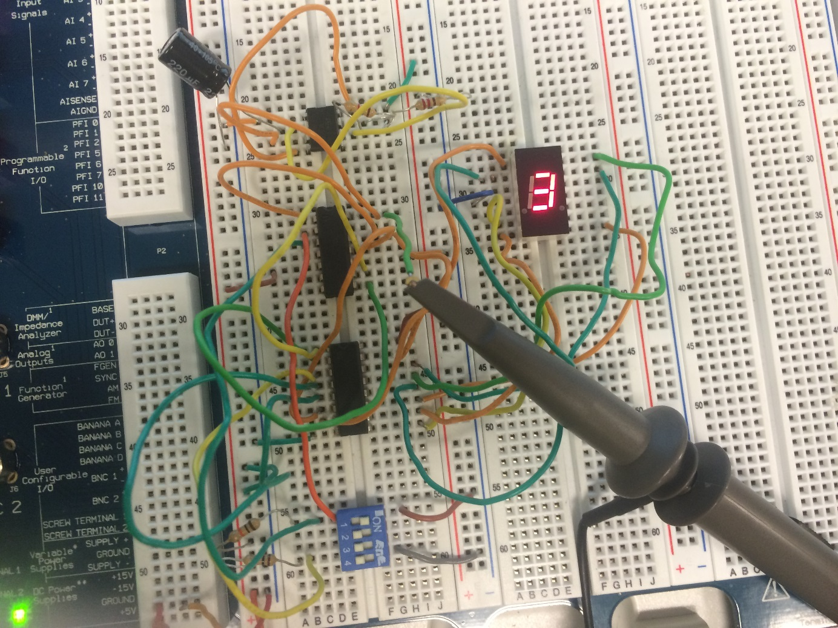
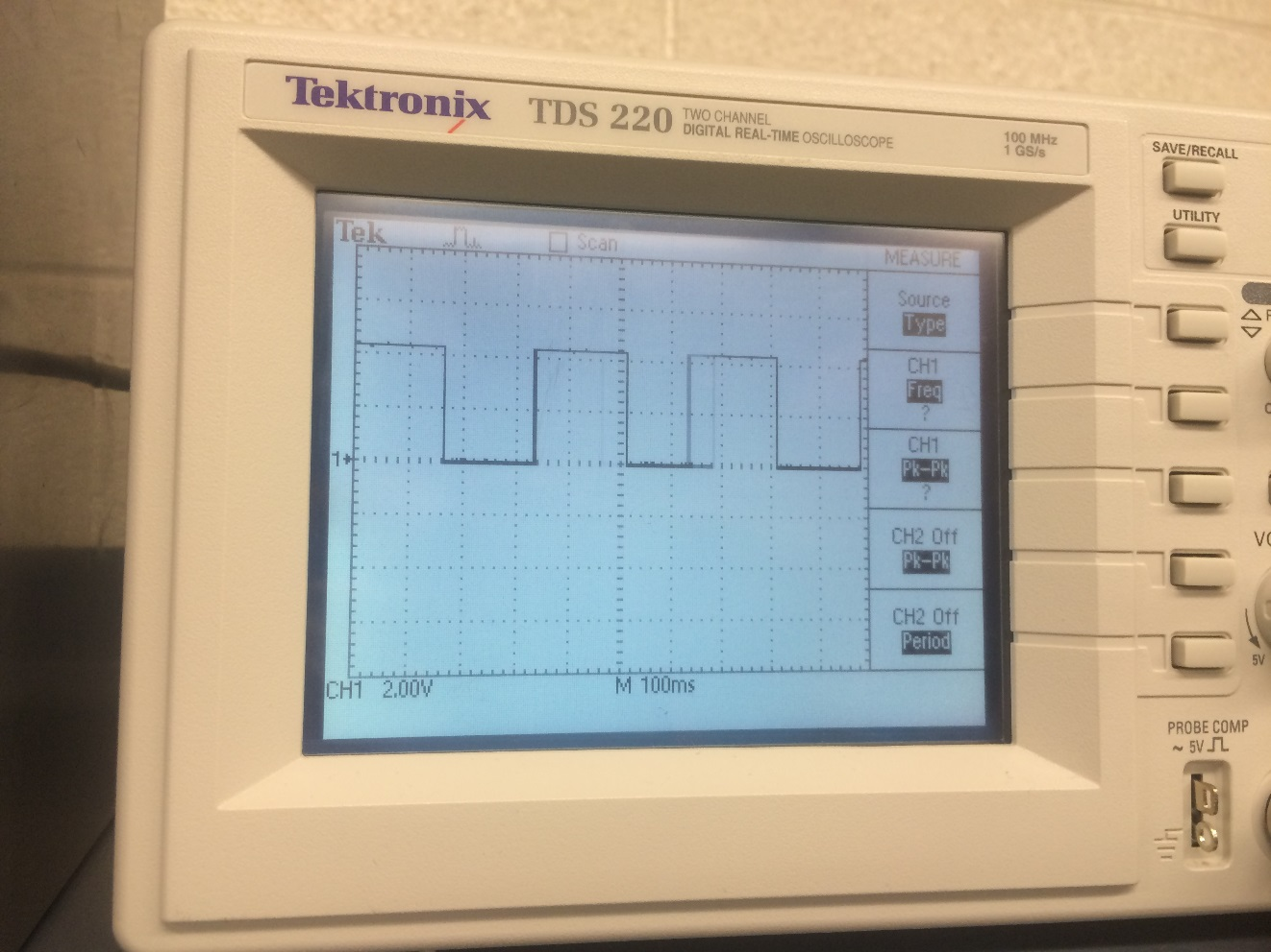
Lab 6 – 4 Bit Counter
Pictures

Slide 51
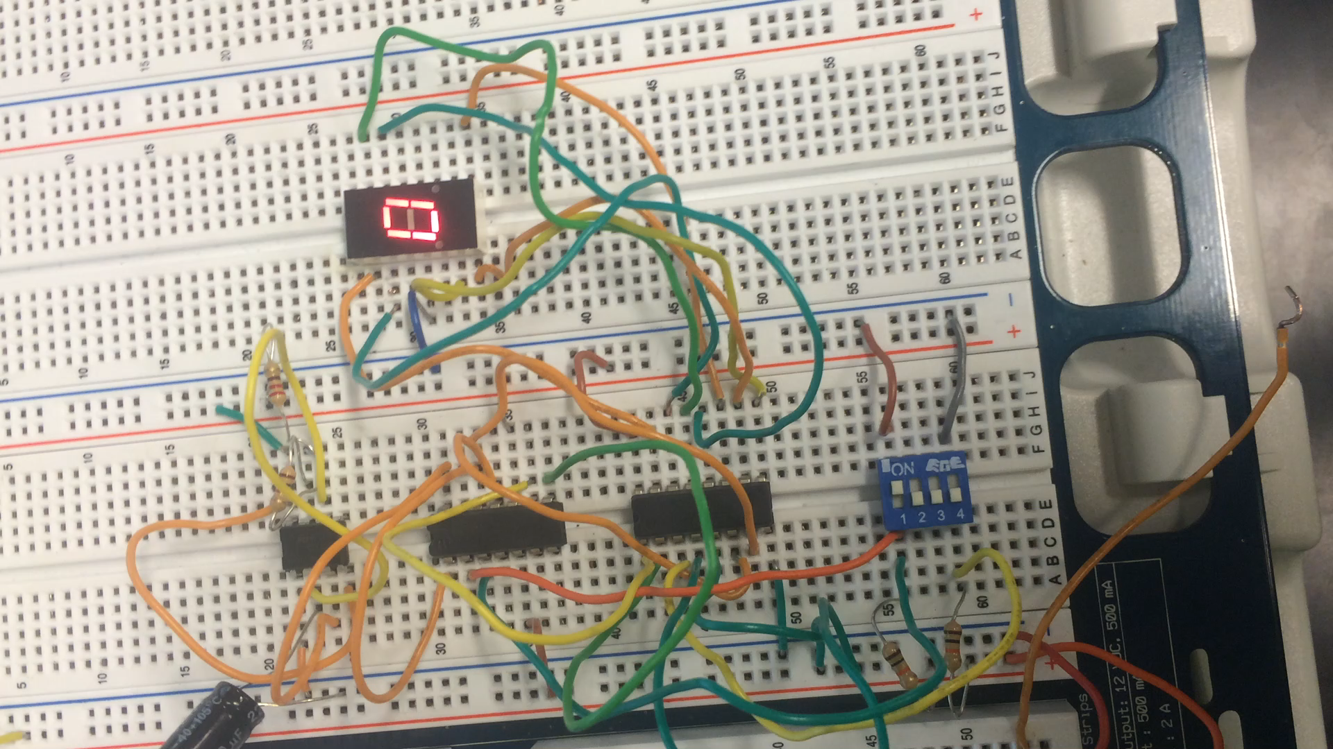
Lab 6 – 4 Bit Counter
Video

Slide 52

Lab 6 – 4 Bit Counter
(Observation)
Learning how to hook up the counter was not easy, this was my first time using one. The datasheets helped, but where a little hard to understand.

Slide 53
Lab 6 – 4 Bit Counter
(Conclusion)
  Everything worked out well, the multisim, excel sheets and lab work all agreed with one another.
  I learned when looking at the chips there is a small dot to indicate which way is front.

Slide 54

Lab 7a – BASIC Stamp:
Single Input/Output

Slide 55
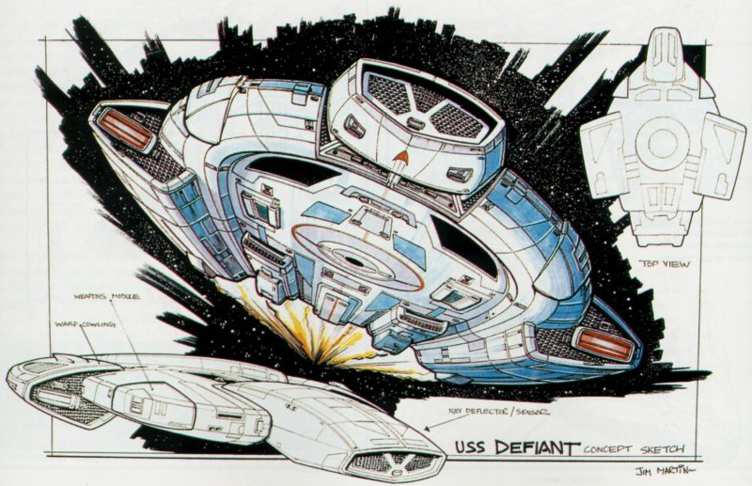
Lab 7a – BASIC Stamp:
Single Input/Output
Purpose
    - To learn about and understand the basic stamp.
Equipment and Material
    Basic Stamp
    Single Input Button
    Single Output LED
Research and Information
  - Datasheets
  - Industrial Control Student Workbook Version 1.1

Slide 56
Lab 7a – BASIC Stamp:
Single Input/Output
Procedures
Build a circuit that has a single input button and a single output LED.
Write a program for when the pushbutton is pressed, blink the LED five times over 10 seconds then stop and wait for another press of the pushbutton.

Slide 57
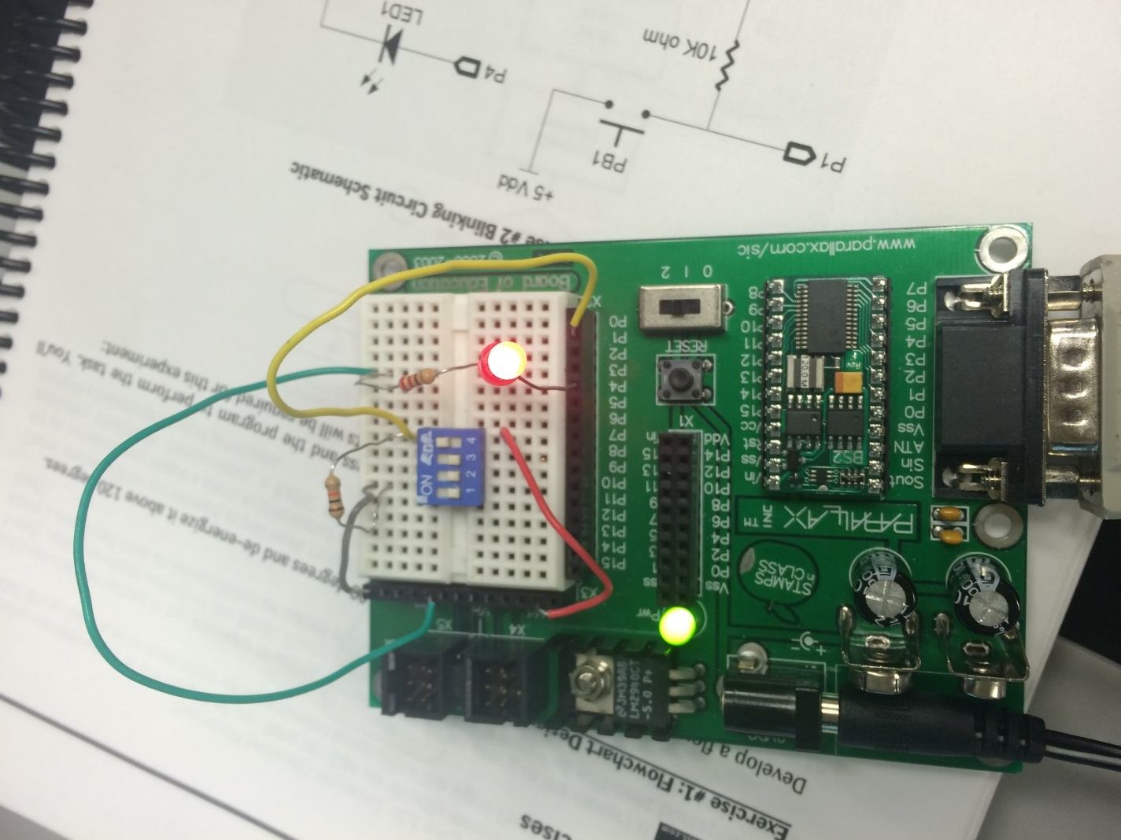
Lab 7a – BASIC Stamp:
Single Input/Output
Pictures

Slide 58
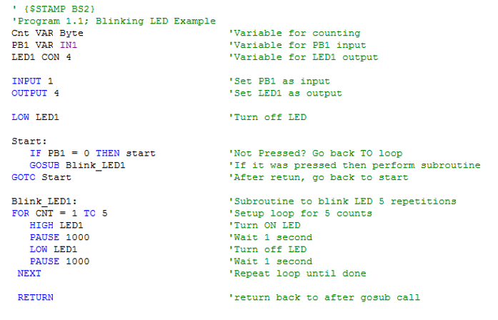
Lab 7a – BASIC Stamp:
Single Input/Output
(Code)

Slide 59
Lab 7a – BASIC Stamp:
Single Input/Output
(Observation)
There are many different ways to code to get to one end result.
One must be careful with how things are put into the code. One missed placed “/” and everything will be made useless.

Slide 60
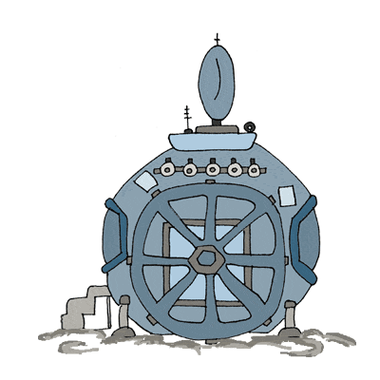
Lab 7a – BASIC Stamp:
Single Input/Output
(Conclusion)
  - After following the books guidance, we were able to successfully get our code to work.
  - This was not a simple task because we were new to basic stamp. However, as complicated as the program may seem, it is rather straight forward.

Slide 61

Lab 7b – BASIC Stamp
Temp Sensor/Heater

Slide 62

Lab 7b – BASIC Stamp: Temp Sensor/Heater
Purpose
    - To write a program to simulate process control of a Heater Control using an RC network with a capacitor and potentiometer.
Equipment and Material
    Basic Stamp
    Capacitor
    Potentiometer
    LED
Research and Information
  - Datasheets
  - Industrial Control Student Workbook Version 1.1

Slide 63
Lab 7b – BASIC Stamp: Temp Sensor/Heater
Procedures
Create a program that will monitor temperature and energize a heater below 100 degrees and de-energize above 120 degrees.
The potentiometer should represent a temperature sensor and the LED will represent the heater being energized.
Debug window will be used to display the temperature and status of the heater.

Slide 64
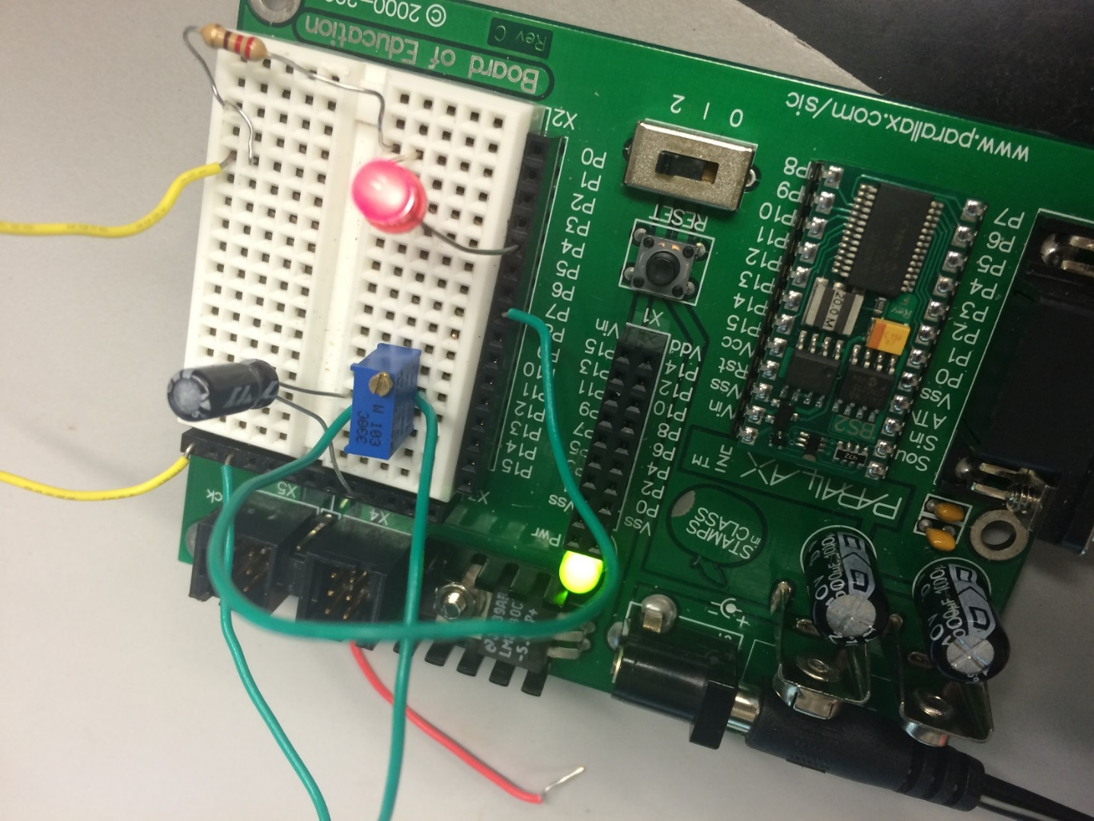
Lab 7b – BASIC Stamp: Temp Sensor/Heater
Pictures

Slide 65
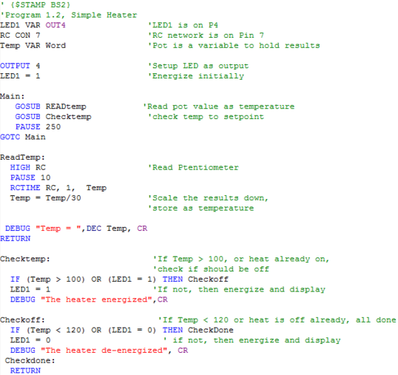
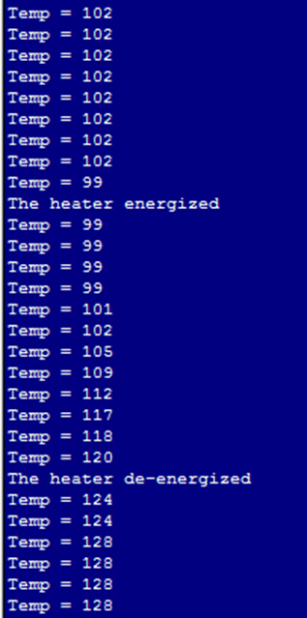
Lab 7b – BASIC Stamp: Temp Sensor/Heater
(Code)

Slide 66
Lab 7b – BASIC Stamp: Temp Sensor/Heater
(Observation)
After having previously worked on a basic stamp project, the coding came easier for this lab.
Still had some issues with coding, quickly found out it was because some things were not labeled properly.

Slide 67
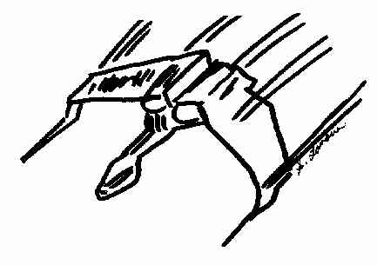
Lab 7b – BASIC Stamp: Temp Sensor/Heater
(Conclusion)
  - Everything worked out in the end.
  - This project taught me how to look for the answers to questions I am not sure how to ask. The student guide was a great help for step by step aid.

Slide 68
Lab 8 – BASIC Stamp Binary Counter (software)

Slide 69
Lab 8 – BASIC Stamp Binary Counter
(software)
Purpose
    To discover how to find out more about Basic Stamp in addition to the programming guide and tutorial built into the software.
Equipment and Material
Basic Stamp
4 LEDs
4 Resistors
Research and Information
Industrial Control Student Workbook Version 1.1

Slide 70

Lab 8 – BASIC Stamp Binary Counter
(software)
Procedures
Build and program a circuit that counts a 4-bit binary
The program should count from 0000 to 1111 in binary using 4 LEDs

Slide 71
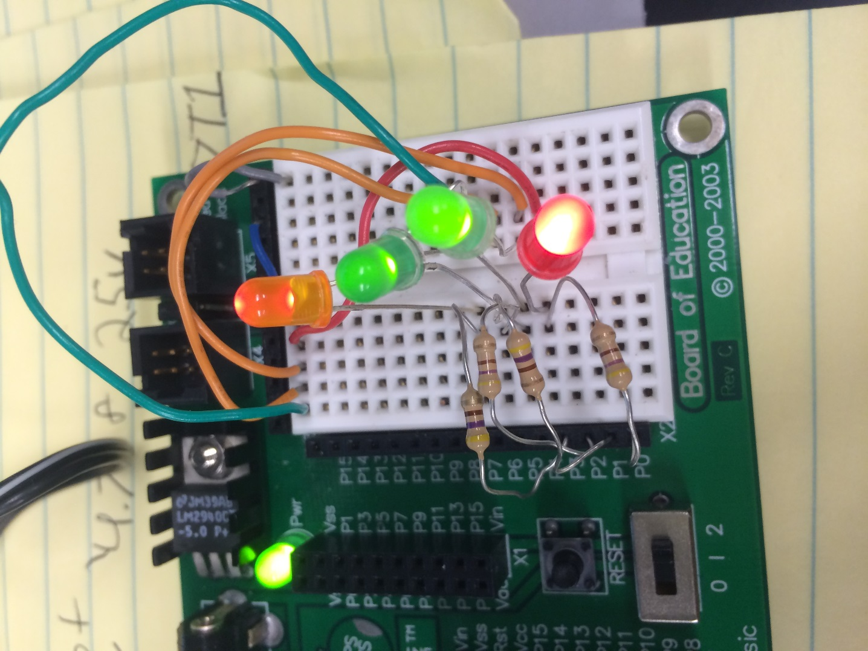
Lab 8 – BASIC Stamp Binary Counter
(software)
Pictures

Slide 72
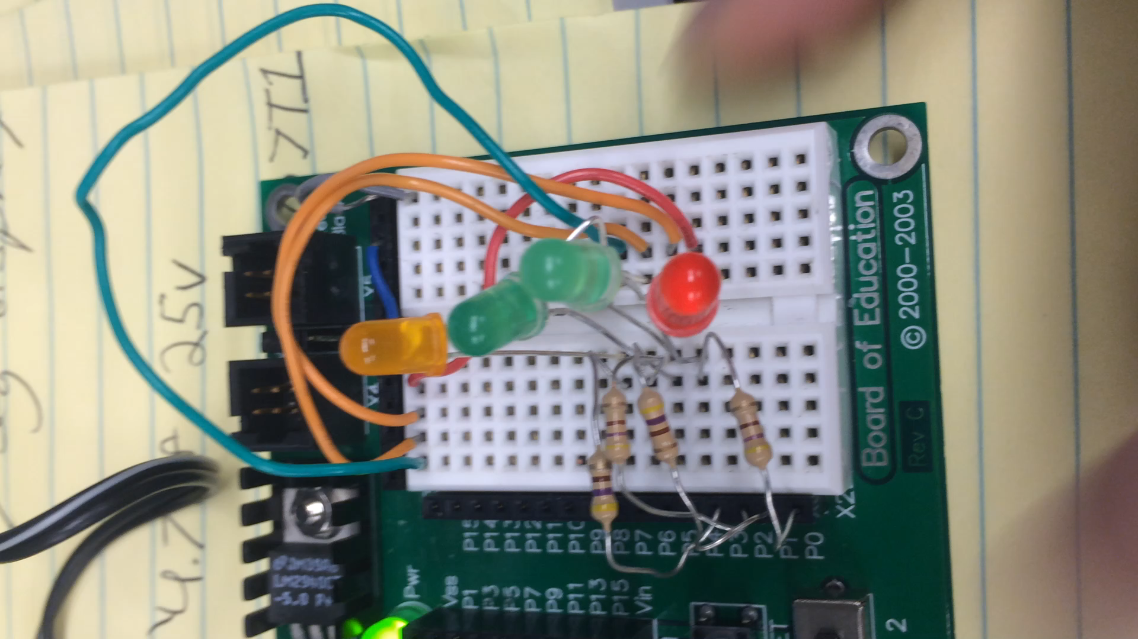
Lab 8 – BASIC Stamp Binary Counter
(software)
Video

Slide 73
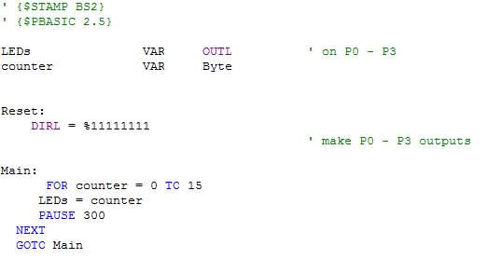
Lab 8 – BASIC Stamp Binary Counter
(software)
(Code)

Slide 74
Lab 8 – BASIC Stamp Binary Counter
(software)
(Observation)
Understanding basic stamp language is far from easy, however it is not difficult to understand. You tell it exactly what you want it to do, and if you mind your P’s and Q’s, it will do as you asked.

Slide 75
Lab 8 – BASIC Stamp Binary Counter
(software)
(Conclusion)
  - The binary counter was easily set up.
  There were no issues with the coding process.
  I really enjoy working in basic stamp. I am far from mastering it, but I believe the program and I have found a mutual understanding.

